Slide 1
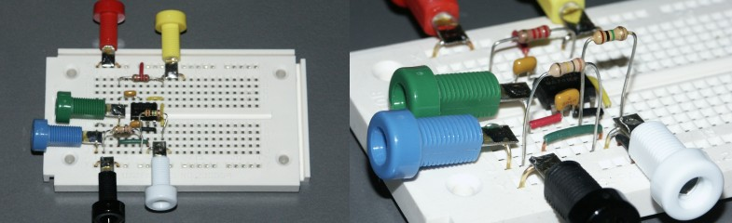


PHY 251 Electronics I CSM251 Introductory Electronics
Kofi’s workbench
Prof. Francis Kofi Ampong
Department of Physics
KNUST

Slide 2
Polite Request: If You Have A Mobile Phone Please Switch It Off Please Do Not Send Or Receive Texts During This Lecture Thank You!

Slide 3
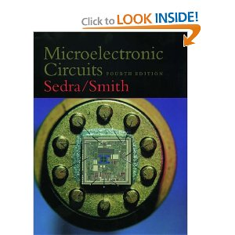
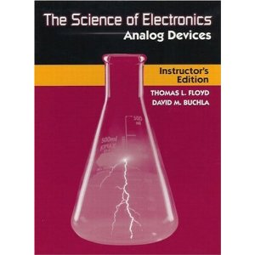
Textbooks
Microelectronic circuits ------(Engineering library) By Sedra and Smith 3rd or higher editions
The Science of Electronics Analog Devices By Thomas L. Floyd David M. Buchla

Slide 4
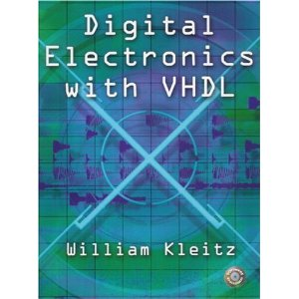
Text book for digital electronics

Slide 5
Course Structure: Lecture sessions , Assignments and Exams
Attendance 5 %
Assignments 5 %
Mid Sem Exam 20 %
End of Sem Exam 70%

Slide 6
Course Objective:
To develop a background knowledge of semiconductor theory sufficient to understand modern semiconductor devices.

Slide 7
Outline of syllabus for CSM/PHY 251
1.1 Basic Semiconductor physics
1.2 The pn Junction
1.3 Analysis of diode circuits
1.4 Applications of diode circuits
1.5 The bipolar junction transistor (BJT) – analysis and applications
1.6 MOSFETs
1.7 Operational Amplifiers

Slide 8
Introduction: What are Semiconductor devices?
Semiconductor devices are electronic components that exploit the electronic properties of semiconductor materials, principally silicon, and germanium.

Slide 9
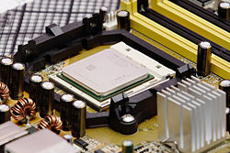
Why are we interested in Semiconductor devices?
In the early days of radio and television, transmitting and receiving equipment relied on vacuum tubes, but these have been completely replaced in the last three decades by
semiconductor devices, which include transistors, diodes, relays integrated circuits and other electronic components.

Slide 10
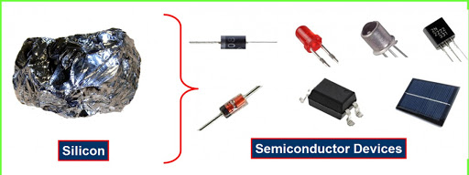
Semiconductor devices, such as transistors and diodes, form the basis of nearly all modern electronic systems.
To understand how diodes, transistors and integrated circuits work, you first have to study semiconductors: materials that are neither conductors nor insulators.

Slide 11
More Reasons
Semiconductor devices are the foundation of the electronic industry, which is the largest industry in the world with global sales over one trillion dollars since 1998.
A basic knowledge of semiconductor devices is essential to understanding of advanced courses in electronics.

Slide 12
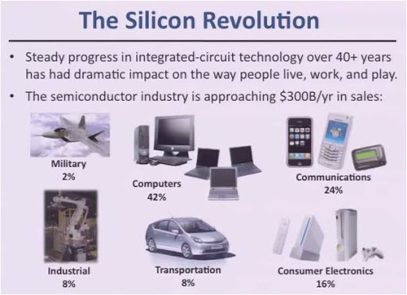

Slide 13
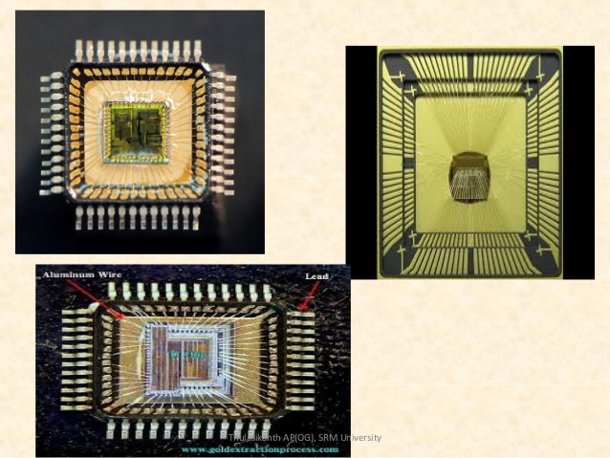

Semiconductor devices serve as the heart of microelectronics.

Slide 14
LECTURE 1: Semiconductors Basics
PHY 251
Electronic I

Slide 15
Introduction
IN THIS LECTURE WE WILL LEARN:
The basic properties of semiconductors and, in particular, silicone – the material used to make most modern electronic circuits.
How doping a pure silicon crystal dramatically changes its electrical conductivity – the fundamental idea in underlying the use of semiconductors in the implementation of electronic devices.

Slide 16
From discrete energy levels to energy bands

Slide 17
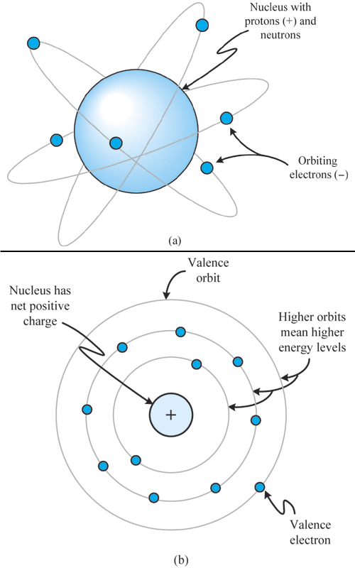
Review of Basic Atomic Model
Atoms are comprised of electrons, neutrons, and protons.
Electrons are found orbiting the nucleus of an at atom at specific intervals, based upon their energy levels.
The outermost orbit is the valence orbit.

Slide 18
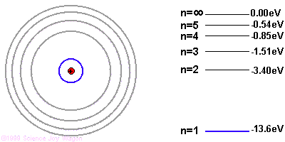
From discrete energy levels to energy bands: - atoms have discrete energy levels which are widely spaced.
The electrons can only be found in these energy states

Slide 19
From discrete energy levels to energy bands
valence electron – is an electron that participates in the formation of chemical bonds.
Atoms with one or two valence electrons more than a closed shell are highly reactive because the extra electrons are easily removed to form positive ions.
covalent bond – is a form of chemical bond in which two atoms share a pair of electrons.
It is a stable balance of attractive and repulsive forces between atoms when they share electrons.

Slide 20
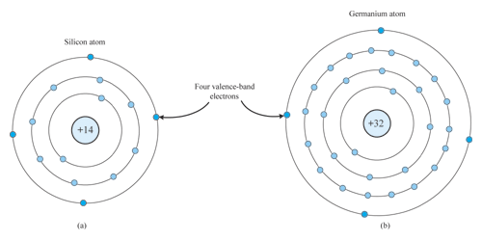
Isolated Semiconductor Atoms
Silicon and Germanium are electrically neutral; that is, each has the same number of orbiting electrons as protons.
Both silicon and germanium have four valence band electrons, and so they are referred to as tetravalent atoms. This is an important characteristic of semiconductor atoms.

Slide 21
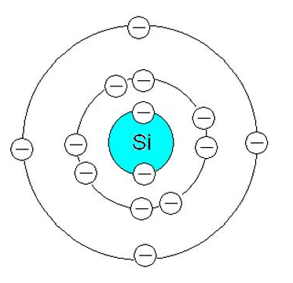
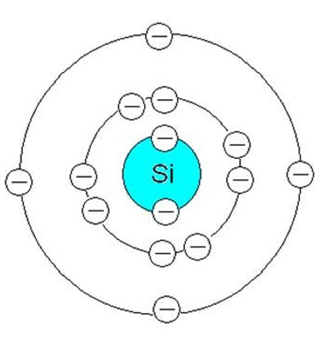
Silicon Covalent Bond Model (cont.)
Silicon has four electrons in the outer shell.
Single crystal material is formed by the covalent bonding of each silicon atom with its four nearest neighbors.
Covalent bond
Silicon atom
Silicon atom

Slide 22
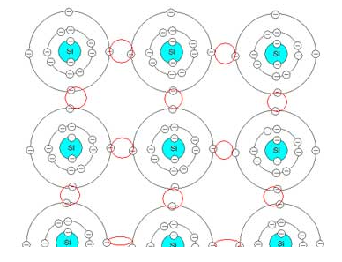
Silicon Covalent Bond Model (cont.)
Silicon atom
Covalent bonds in silicon
On the average, each silicon atom will have eight electrons in its outermost shell

Slide 23
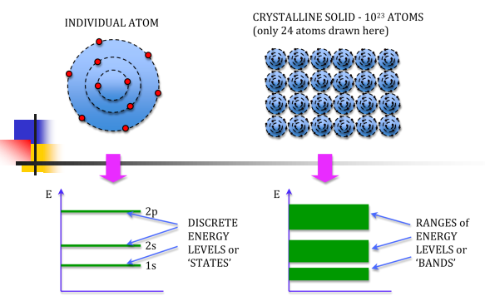
Silicon Covalent Bond Model (cont.)

Slide 24
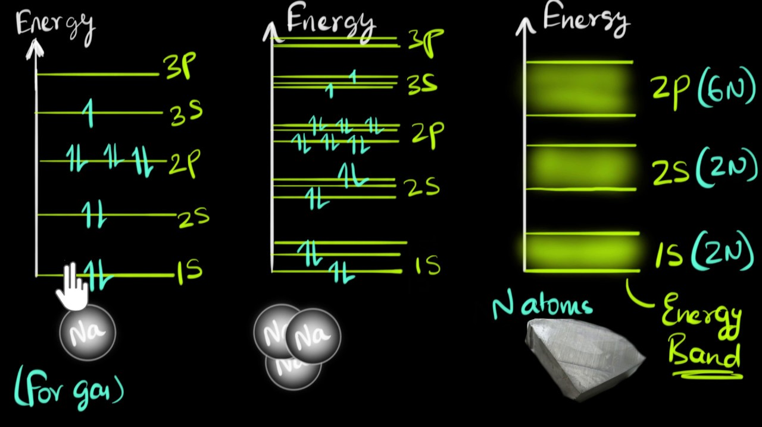

Slide 25
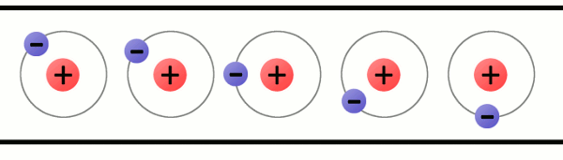
Conduction in materials
What is crucial to the conduction process is the availability of free electrons.
That is before a material can conduct electric current it must have some electrons which can move freely inside the material.
In silicon the bonding process uses up all the available electrons, so at absolute zero temperature, there are no electrons available for conduction.

Slide 26
Si
Si
Si
Si
Si
Si
Si
Si
Si
At finite temperatures however, the atoms vibrate randomly, having occasionally much more than the average thermal energy

Slide 27
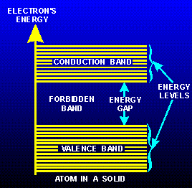
Si
Si
Si
Si
Si
Si
At certain instants at certain atoms there is there is enough energy to break the covalent bond and liberate an electron. Once liberated, they wander aimlessly through the crystal, and are said to be in the conduction band, where they can contribute to electric current. Those electrons which still remain bound are said to be in the valence band
Si
Si
Si

Slide 28
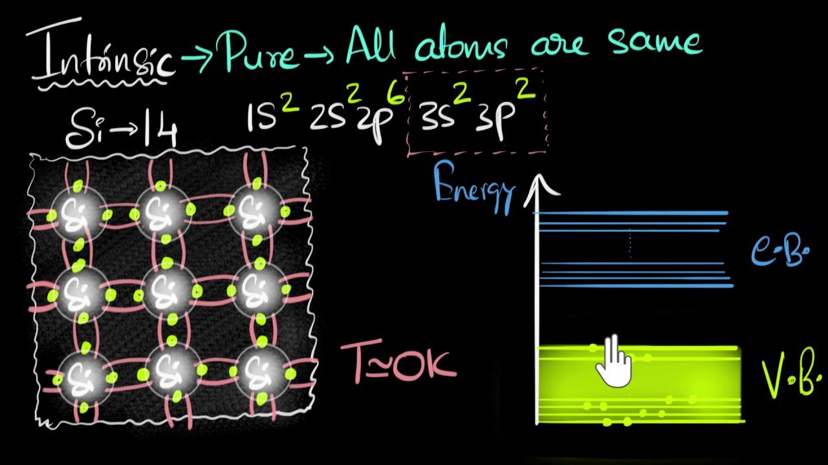

Slide 29
So what can we say about this?
We may say that all the electrons are in the valence band at 0ºK (that is all electrons remain bound to their parent atom).
There is an energy gap above the valence band before the conduction band starts.
This means that for an electron to be in the conduction band; that is, to get an electron in a state in which it can take up kinetic energy from an electric field and can contribute to an electric current, we first have to give it a package of energy.
This can come from thermal excitation, or by photon excitation quite independently of temperature

Slide 30
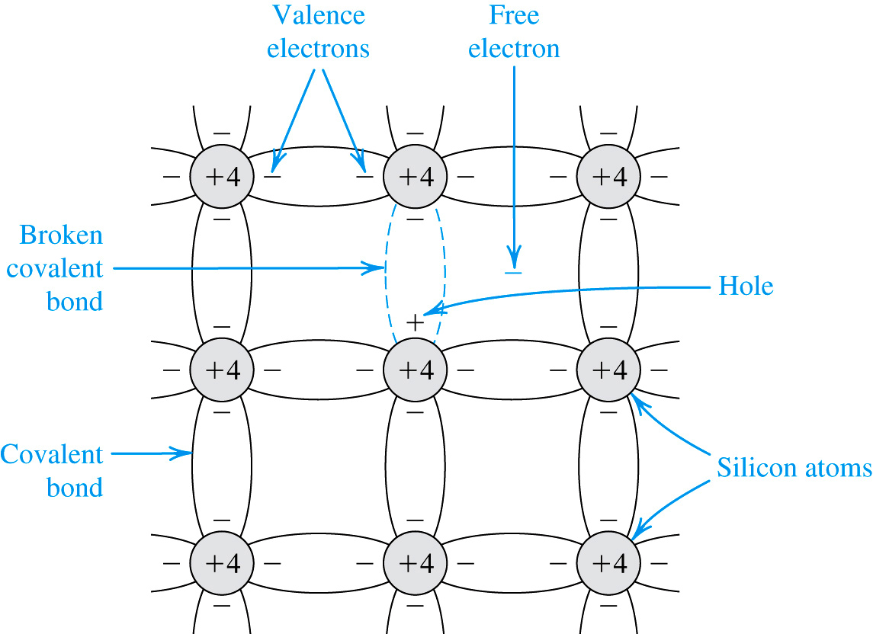
3.1: Intrinsic Semiconductors
Figure 3.2: At room temperature, some of the covalent bonds are broken by thermal generation. Each broken bond gives rise to a free electron and a hole, both of which become available for current conduction.
silicon at low temps:
all covalent bonds are intact
no electrons are available for conduction
conducitivity is zero
silicon at room temp:
sufficient thermal energy exists to break some covalent bonds, freeing an electron and creating hole
a free electron may wander from its parent atom
a hole will attract neighboring electrons
the process of freeing electrons, creating holes, and filling them facilitates current flow

Slide 31

Questions ?
Can you think of a device that generates free electrons when external energy such as light is applied to it?

Slide 32
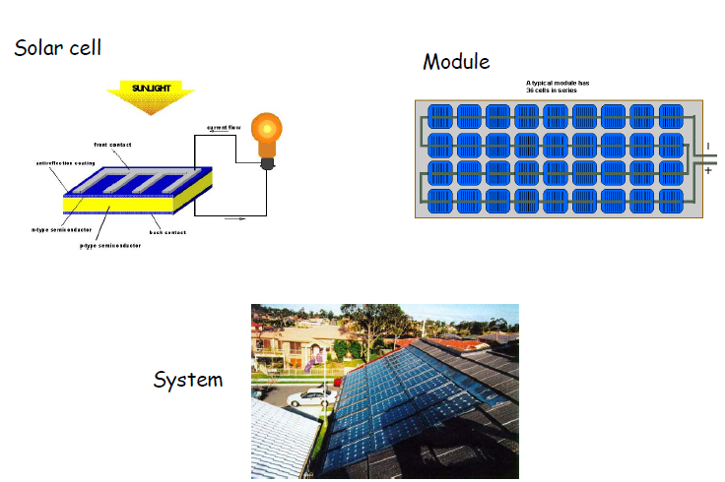

Slide 33
Energy-band Diagram
A very important concept in the study of semiconductors is the energy-band diagram
It is used to represent the range of energy a valence electron can have
For semiconductors the electrons can have any one value of a continuous range of energy levels while they occupy the valence shell of the atom
That band of energy levels is called the valence band
Within the same valence shell, but at a slightly higher energy level, is yet another band of continuously variable, allowed energy levels
This is the conduction band

Slide 34
Energy-band diagram – classification of materials
Insulator
Semiconductor
Conductor
Conductor
Conduction Band
Conduction Band
Conduction Band
Conduction Band
Energy Gap
Energy Gap
Valence Band
Valence Band
Valence Band
Empty allowed energy band
Full allowed energy band

Slide 35
Band Gap
Between the valence and the conduction band is a range of energy levels where there are no allowed states for an electron
This is the band gap
In silicon at room temperature [in electron volts]:
Electron volt is an atomic measurement unit, 1 eV energy is necessary to decrease of the potential of the electron with 1 V.

Slide 36
Insulators, Semiconductors, and Metals
This separation of the valence and conduction bands determines the electrical properties of the material
Insulators have a large energy gap
electrons can’t jump from valence to conduction bands
no current flows
Conductors (metals) have a very small (or nonexistent) energy gap
electrons easily jump to conduction bands due to thermal excitation
current flows easily
Semiconductors have a moderate energy gap
only a few electrons can jump to the conduction band
leaving “holes”
only a little current can flow

Slide 37
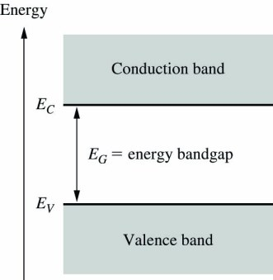
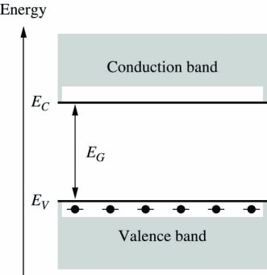
Semiconductor Energy Band Model
What happens as temperature increases?
Semiconductor energy band model. E_{C} and E_{V} are energy levels at the edge of the conduction and valence bands.
Electron participating in a covalent bond is in a lower energy state in the valence band. This diagram represents 0 K.

Slide 38
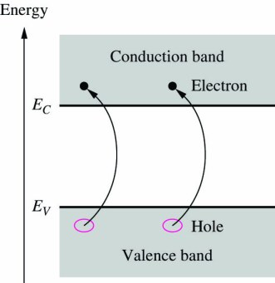
Semiconductor Energy Band Model
Semiconductor energy band model. E_{C} and E_{V} are energy levels at the edge of the conduction and valence bands.
Electron participating in a covalent bond is in a lower energy state in the valence band. This diagram represents 0 K.
Thermal energy breaks covalent bonds and moves the electrons up into the conduction band.

Slide 39
Semiconductor energy bands at room temperature
When enough energy is supplied to the e⁻ sitting at the top of the valance band, e⁻ can make a transition to the bottom of the conduction band.
When electron makes such a transition it leaves behind a missing electron state.
This missing electron state is called as a hole.
Hole behaves as a positive charge carrier.
Magnitude of its charge is the same with that of the electron but with an opposite sign.
Empty
conduction
band
Forbidden
energy gap [Eg]
e⁻
e⁻
e⁻
e⁻
energy
+
+
+
+
Full
valance
band

Slide 40

3-2. Carriers in Semiconductors
Ec
300º^{K}
Eg
18º^{K}
11º^{K}
14º^{K}
15º^{K}
20º^{K}
19º^{K}
12º^{K}
13º^{K}
17º^{K}
16º^{K}
4º^{K}
1º^{K}
2º^{K}
0º^{K}
3º^{K}
10º^{K}
5º^{K}
6º^{K}
7º^{K}
8º^{K}
9º^{K}
Ev
Electron Hole Pair
E
H
P

Slide 41
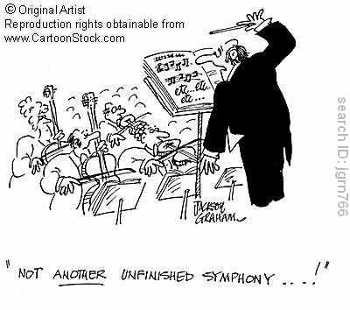
THE SEMICONDUCTOR
With the aid of the band theory we have succeeded in classifying solids into metals, insulators and semiconductors. We are now going to consider semiconductors (technologically the newest class) in more detail

Slide 42
Semi-conductor concepts
Semiconductors are a group of solids whose electrical properties are intermediate between conductors and insulators. For example, the resistivity of a conductor is of the order of 10⁻⁸ Ωm, that of an insulator is 10⁴ Ωm and above whiles that of a semiconductor is 10⁻¹Ωm.
Most semiconductor devices require materials with an energy gap of about 1eV at normal room temperature. Hence, the most extensively used semiconducting elements in the electronic industry are silicon (1.2eV) and germanium (0.76 eV). Silicon and germanium are group IV elements

Slide 43
Semiconductors
A material whose properties are such that it is not quite a conductor, not quite an insulator
Some common semiconductors
elemental
Si - Silicon (most common)
Ge - Germanium
compound
GaAs - Gallium arsenide
GaP - Gallium phosphide
AlAs - Aluminum arsenide
AlP - Aluminum phosphide
InP - Indium Phosphide

Slide 44
The name “semiconductor” implies that it conducts somewhere between the two cases (conductors or insulators)
Conductivity :
σmetals ~10¹⁰ /Ω-cm
σinsulators ~ 10⁻²² /Ω-cm
The conductivity (σ) of a
semiconductor (S/C) lies
between these two
extreme cases.
S/C

Slide 45
Basic Semiconductor Concepts
Intrinsic Semiconductor
Doped Semiconductor

Slide 46
3.1: Intrinsic Semiconductors
At room temperature, some of the covalent bonds are broken by thermal generation. Each broken bond gives rise to a free electron and a hole, both of which become available for current conduction.
silicon at low temps:
all covalent bonds are intact
no electrons are available for conduction
conducitivity is zero
silicon at room temp:
sufficient thermal energy exists to break some covalent bonds, freeing an electron and creating hole
a free electron may wander from its parent atom
a hole will attract neighboring electrons
the process of freeing electrons, creating holes, and filling them facilitates current flow

Slide 47
Intrinsic Semiconductors
thermal generation – effects a equal concentration of free electrons and holes.
Therefore, electrons move randomly throughout the material.
In thermal equilibrium, generation and recombination rates are equal.
Notes:
The holes and electrons are randomly distributed in the material.

Slide 48
Intrinsic Semiconductors
intrinsic semiconductor – is one which is not doped
One example is pure silicon.
generation – is the process of free electrons and holes being created.
generation rate – is speed with which this occurs.
recombination – is the process of free electrons and holes disappearing.
recombination rate – is speed with which this occurs.
Generation may be effected by thermal energy. As such, both generation and recombination rates will be (at least in part) a function of temperature.
Notes:
We are assuming pure Crystalline semiconductors as opposed to amorphous semiconductor materials

Slide 49
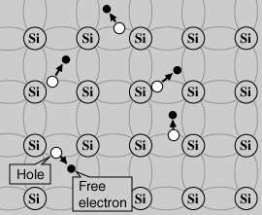
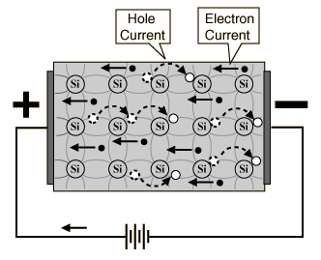
Intrinsic semiconductor

Slide 50
Electron Distribution
As more energy is applied to a semiconductor, more electrons will move into the conduction band and current will flow more easily through the material.
Therefore, the resistance of intrinsic semiconductor materials decreases with increasing temperature.
This is a negative temperature coefficient.

Slide 51
Intrinsic carrier concentration in semiconductors
The density of carriers in a semiconductor as a function of temperature and material properties is:
n_{i} = number of free electrons and holes in a unit volume for intrinsic semiconductor
Ns = parameter whose precise value depends on the material
T = temperature (K)
E_{g} = bandgap energy
k = Boltzman constant
Notes:
This is the Fermi-Dirac distribution. See http://DoctorD.webhop.net/Courses/BEI/EE231/supplement1_carrierconc.pdf

Slide 52
Free Electron Density at a Given Temperature
E_{g}, or bandgap energy determines how much effort is needed to break off an electron from its covalent bond.
There exists an exponential relationship between the free-electron density and bandgap energy.

Slide 53
Electron-hole concentrations
A vacancy is left when a covalent bond is broken.
The vacancy is called a hole.
A hole moves when the vacancy is filled by an electron from a nearby broken bond (hole current).
The electron density is n (n_{i} for intrinsic material)
Hole density is represented by p.
For intrinsic silicon, n = n_{i} = p.
The product of electron and hole concentrations is pn = n_{i}².
The pn product above holds when a semiconductor is in thermal equilibrium (not with an external voltage applied).

Slide 54
Problem
The problem with intrinsic semiconductors are;
Charge carriers are thermally generated and very few in number resulting in very little current.
Thus for device applications, where an appreciable current is required we need to carry out the “doping process” resulting in extrinsic semiconductors

Slide 55
Semiconductor Doping
The interesting properties of semiconductors emerges when impurities are introduced.
Doping is the process of adding very small well controlled amounts of impurities into a semiconductor.
Doping enables the control of the resistivity and other properties over a wide range of values.
For silicon, impurities are from columns III and V of the periodic table.

Slide 56
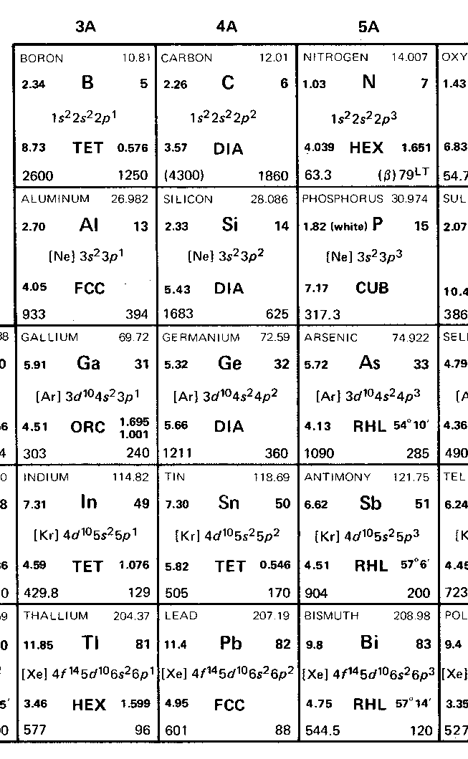
Doped Semiconductors
lattice
p-type dopants
n-type dopants

Slide 57
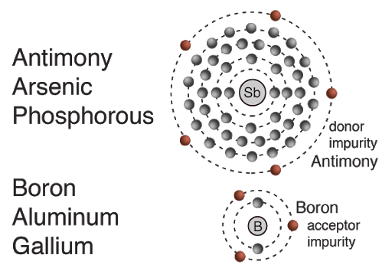

Slide 58
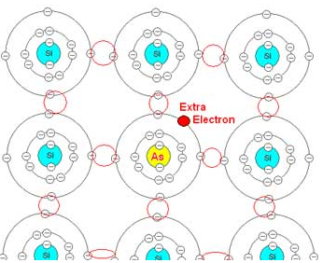
Donor Impurities in Silicon
Phosphorous (or other column V element) atom replaces silicon atom in crystal lattice.
Since phosphorous has five outer shell electrons, there is now an ‘extra’ electron in the structure.
Material is still charge neutral, but very little energy is required to free the electron for conduction since it is not participating in a bond.

Slide 59
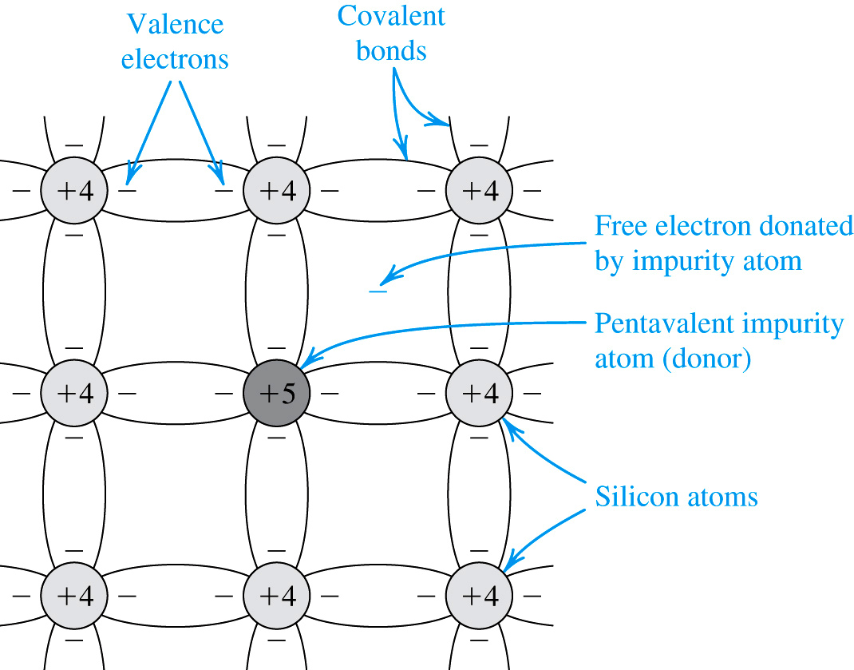
Donor Impurities in Silicon
Phosphorous (or other column V element) atom replaces silicon atom in crystal lattice.
Since phosphorous has five outer shell electrons, there is now an ‘extra’ electron in the structure.
Material is still charge neutral, but very little energy is required to free the electron for conduction since it is not participating in a bond.
A silicon crystal doped by a pentavalent element (f. i. phosphorus). Each dopant atom donates a free electron and is thus called a donor. The doped semiconductor becomes n type.

Slide 60
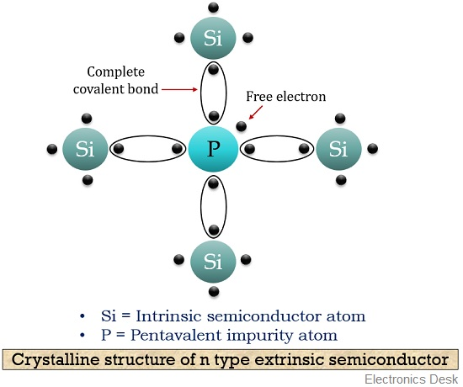

Slide 61
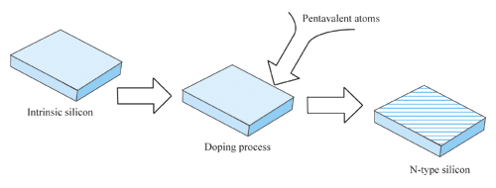
Pentavalent Doping

Slide 62
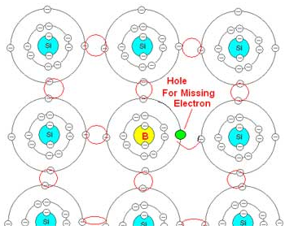
Acceptor Impurities in Silicon
Boron (column III element) has been added to silicon.
There is now an incomplete bond pair, creating a vacancy for an electron.
Little energy is required to move a nearby electron into the vacancy.
As the ‘hole’ propagates, charge is moved across the silicon.

Slide 63
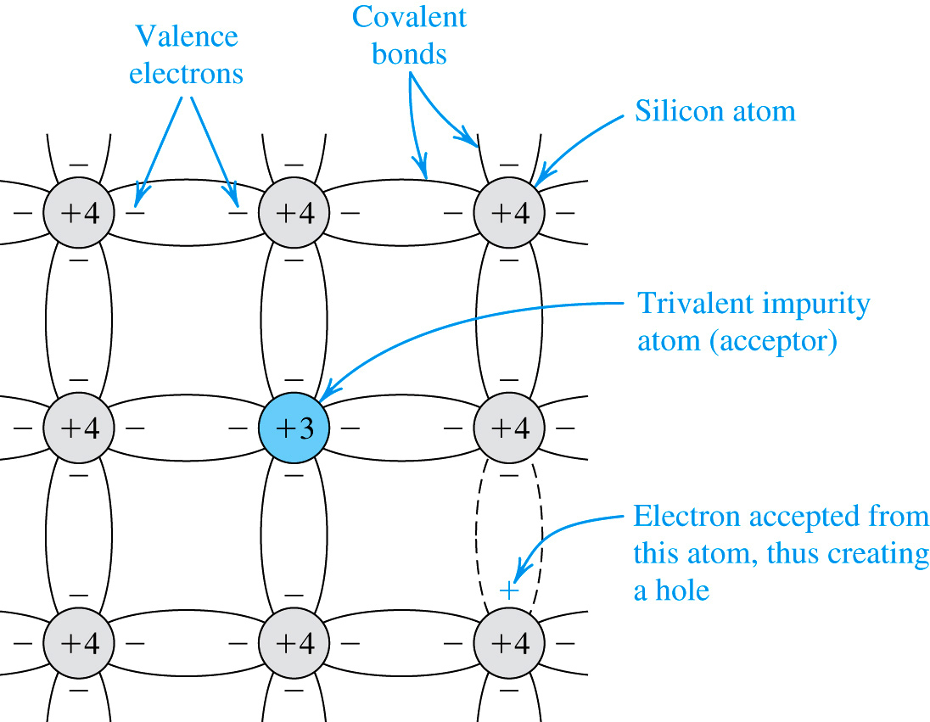
Acceptor Impurities in Silicon
Boron (column III element) has been added to silicon.
There is now an incomplete bond pair, creating a vacancy for an electron.
Little energy is required to move a nearby electron into the vacancy.
As the ‘hole’ propagates, charge is moved across the silicon.
Vacancy
A silicon crystal doped with a trivalent impurity (f.i. boron). Each dopant atom gives rise to a hole, and the semiconductor becomes p type.

Slide 64
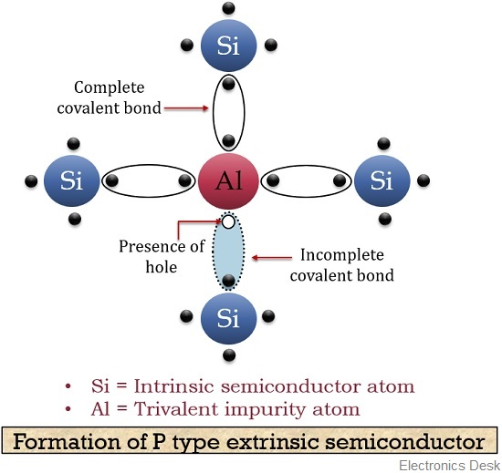

Slide 65
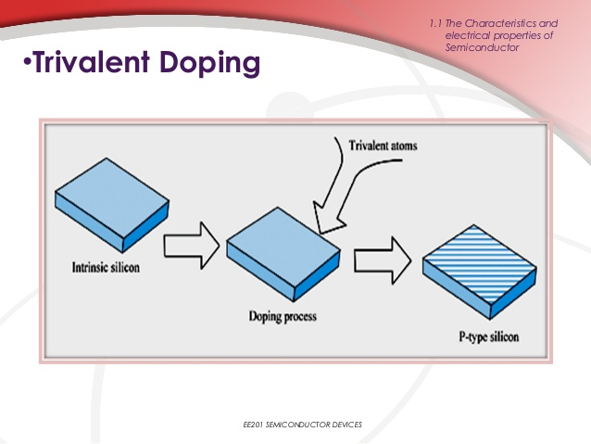

Slide 66
Doped Semiconductor
Doped semiconductors are materials in which carriers of one kind predominate.
Only two types of doped semiconductors are available.
Conductivity of doped semiconductor is much greater than the one of intrinsic semiconductor.
The pn junction is formed by doped semiconductor.

Slide 67
Doped Semiconductor(cont’d)
Majority carrier is only determined by the impurity, but independent of temperature.
Minority carrier is strongly affected by temperature.
If the temperature is high enough, characteristics of doped semiconductor will decline to the one of intrinsic semiconductor.

Slide 68
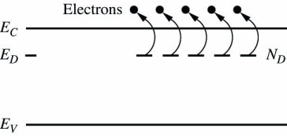
Energy Band Model for a Doped Semiconductor
Semiconductor with donor or n-type dopants. The donor atoms have free electrons with energy E_{D}. Since E_{D} is close to E_{C}, (about 0.045 eV for phosphorous), it is easy for electrons in an n-type material to move up into the conduction band.

Slide 69
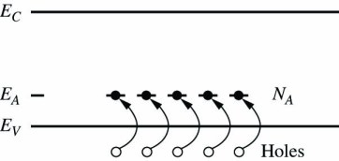
Energy Band Model for a Doped Semiconductor
Semiconductor with donor or n-type dopants. The donor atoms have free electrons with energy E_{D}. Since E_{D} is close to E_{C}, (about 0.045 eV for phosphorous), it is easy for electrons in an n-type material to move up into the conduction band and create negative charge carriers.
Semiconductor with acceptor or p-type dopants. The acceptor atoms have unfilled covalent bonds with energy state E_{A}. Since E_{A} is close to E_{V}, (about 0.044 eV for boron), it is easy for electrons in the valence band to move up into the acceptor sites and complete covalent bond pairs, and create holes – positive charge carriers.

Slide 70
Extrinsic Material
V
P
As
Sb
Ec
Ed
50º^{K}
18º^{K}
11º^{K}
14º^{K}
15º^{K}
20º^{K}
19º^{K}
12º^{K}
13º^{K}
17º^{K}
16º^{K}
4º^{K}
1º^{K}
2º^{K}
0º^{K}
3º^{K}
10º^{K}
5º^{K}
6º^{K}
7º^{K}
8º^{K}
9º^{K}
Ev
Donor

Slide 71
Extrinsic Material
ш
B
Al
Ga
In
Ec
50º^{K}
18º^{K}
11º^{K}
14º^{K}
15º^{K}
20º^{K}
19º^{K}
12º^{K}
13º^{K}
17º^{K}
16º^{K}
4º^{K}
1º^{K}
2º^{K}
0º^{K}
3º^{K}
10º^{K}
5º^{K}
6º^{K}
7º^{K}
8º^{K}
9º^{K}
Ea
Ev
Acceptor

Slide 72
Hole and Electron Concentrations
To produce reasonable levels of conduction doesn’t require much doping
silicon has about 5 x 10²² atoms/cm³
typical dopant levels are about 10¹⁵ atoms/cm³
In undoped (intrinsic) silicon, the number of holes and number of free electrons is equal, and their product equals a constant
actually, n_{i} increases with increasing temperature
This equation holds true for doped silicon as well, so increasing the number of free electrons decreases the number of holes
np = n_{i}²

Slide 73
Electron and Hole Densities
Majority Carriers :
Minority Carriers :
Majority Carriers :
Minority Carriers :
The product of electron and hole densities is ALWAYS equal to the square of intrinsic electron density regardless of doping levels.

Slide 74
Questions ?

Slide 75
pn Junction
The pn junction under open-circuit condition
Diffusion and Drift currents
The pn junction under closed circuit conditions
Forward bias
Reverse bias
I-V characteristic of pn junction
Terminal characteristic of junction diode.

Slide 76
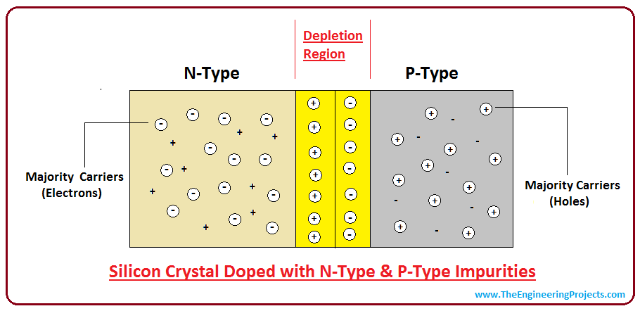

Slide 77
Introduction
IN THIS LECTURE WE WILL LEARN:
The two mechanisms by which current flows in semiconductors – drift and diffusion charge carriers.
The structure and operation of the pn junction – a basic semiconductor structure that implements the diode and plays a dominant role in semiconductors.

Slide 78
P-N Junction
Open circuit conditions
The p-n junction possesses some interesting properties which have useful applications in modern electronics. Thus an understanding of the physical operations of p-n junctions is important to the understanding of the operation and terminal characteristics these electronic devices

Slide 79
P-N JUNCTION FORMATION
Three important phenomena occur during the formation of a P-N Junction namely;
Diffusion
Space charge
Drift

Slide 80
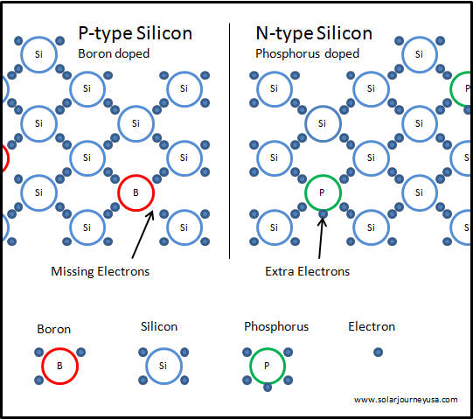

Slide 81
Formation of the P-N Junction
Electron diffusion
As
B
Covalent bond
Free electron
As
B
Hole
N
P
As
B
Silicon atom
As
B
As
B
Hole diffusion
P-N Junction

Slide 82
Depletion Region/Space Charged Region
+
-
The combining of electrons and holes depletes the holes in the p-region and electrons in the n-region near the junction
As
B
N
P
+
-
As
B
+
-

Slide 83
As a result of the barrier pd, an electric field is set up in the depletion region, and it prevent further diffusion of charge carriers across the junction.
+
-
As
B
N
P
+
-
As
B
+
-

Slide 84
P-N Junction formation
As the free electrons move across the junction from n-type to p-type, +ve donor ions are uncovered. Hence a +ve charge is built on the n-side of the junction. At the same time, the free electrons cross the junction and uncover the –ve acceptor ions by filling in the holes. Therefore a net –ve charge is established on p-side of the junction.

Slide 85
P-N Junction formation
When a sufficient number of donor and acceptor ions are uncovered further diffusion is prevented.
Thus a barrier is set up against further movement of charge carriers. This is called potential barrier or junction barrier Vo. The potential barrier is of the order of 0.1 to 0.3V.
Note: outside this barrier on each side of the junction, the material is still neutral. Only inside the barrier, there is a +ve charge on n-side and –ve charge on p-side. This region is called depletion layer.

Slide 86
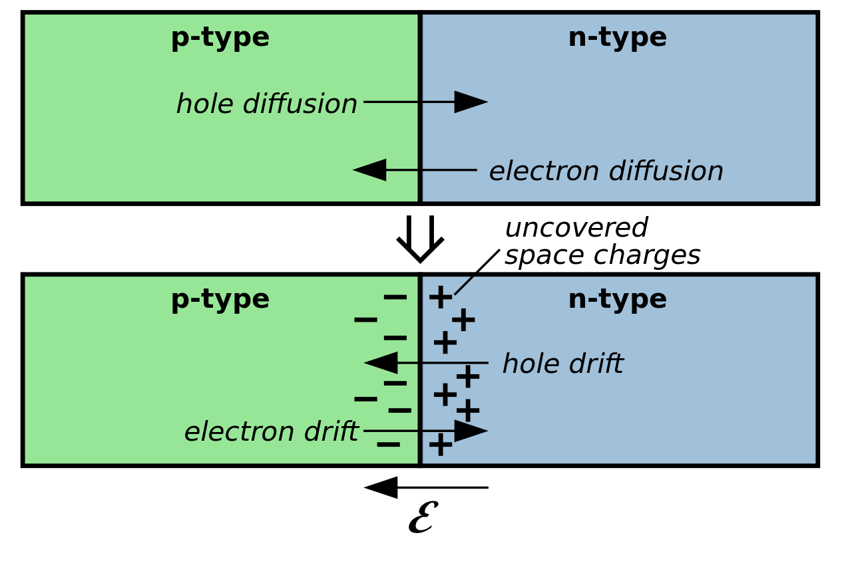
Drift Current
In addition to the current component, I_{D}, due to majority carrier diffusion, a component due to minority carrier drift exists across the junction.

Slide 87
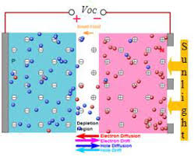
If for some reason, I_{D} exceeds I_{s}, then more bound charge will be uncovered on both sides of the junction, the depletion layer will widen and the voltage across it V_{o} will increase. This in turn causes I_{D} to decrease until equilibrium is achieved with I_{D} = Is.

Slide 88
On the other hand, if I_{s} exceeds I_{D}, then the amount of uncovered charge will decrease, the depletion layer will narrow and the voltage across it will decrease. This causes I_{D} to increase until equilibrium is achieved with I_{D} = I_{s}

Slide 89
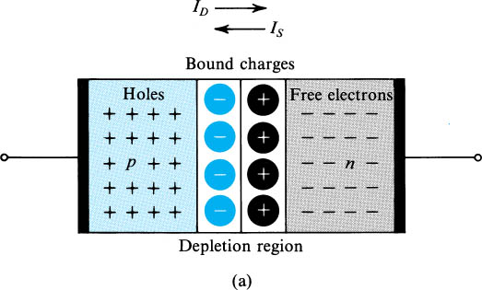
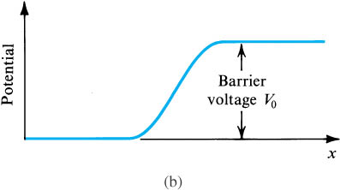
pn Junction Under Open-Circuit Condition
Fig (a) shows the pn junction with no applied voltage (open-circuited terminals).
Under open circuit conditions, no external current exists; thus the two opposite currents across the junction should be equal in magnitude i.e., I_{D} = I_{s}..

Slide 90
Summary of Procedure for Forming pn Junction
The procedure of forming pn the dynamic equilibrium of drift and diffusion movements for carriers in the silicon. In detail, there are 4 steps:
Diffusion
Space charge region
Drift
Equilibrium

Slide 91
Procedure of Forming pn Junction
diffusion
Both the majority carriers diffuse across the boundary between p-type and n-type semiconductor.
The direction of diffusion current is from p side to n side.

Slide 92
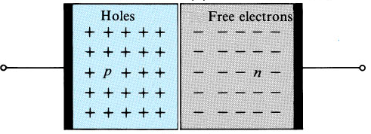
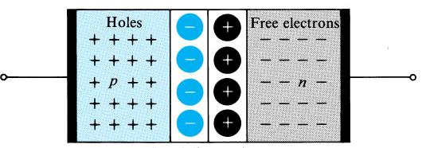
3.7.2 The pn junction Under Open-Circuit Conditions
Diffusion current!
E field
Diffusion
Acceptors (B, III) accept, recombine with electrons and become (-).
Donors (P, IV) donate electrons and become (+).
Drift current!
Minority carriers
This process produces electric potential and field and stops when coulomb force equals to diffusion mechanism.
E field
0.1~1 μm
There is no free electron and holes in this region.
This region is depleted of free carriers !!
0.6~0.8 V
Notes:
sedr42021_0345a.jpg

Slide 93
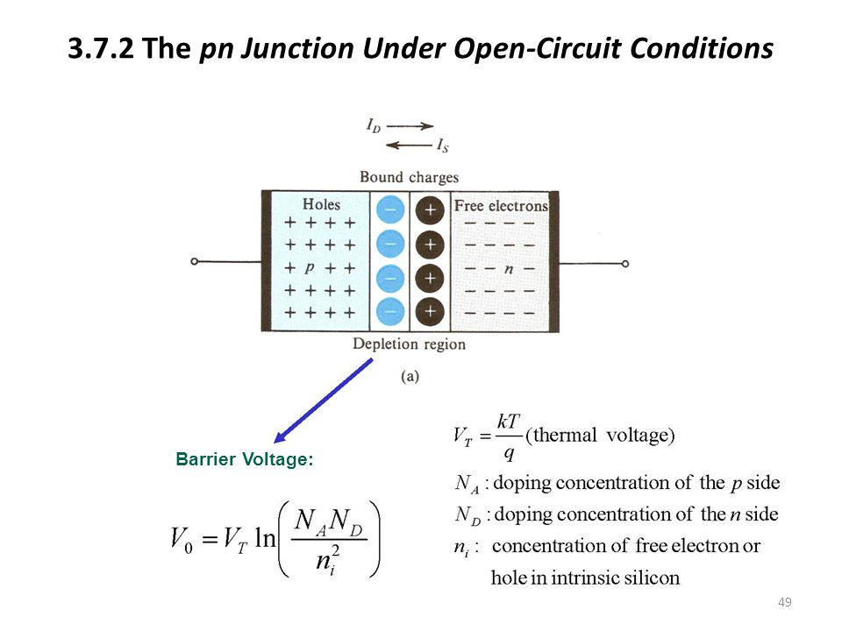

Slide 94
P-N Junction
Closed circuit conditions

Slide 95
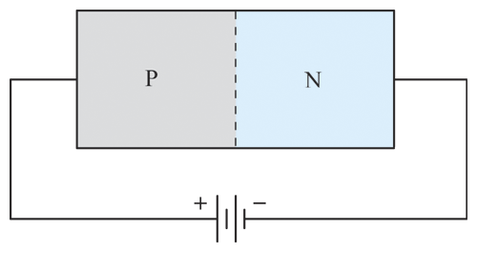
Forward Biased Junction
An external source can either oppose or aid the barrier potential.
If the positive side of the voltage is connected to the p-type material, and the negative side to the n-type material, then the junction is said to be forward biased.

Slide 96
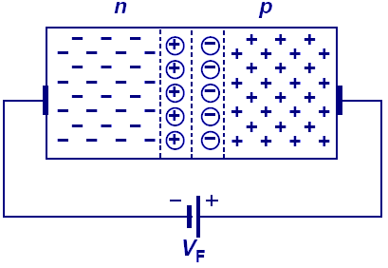
P-N Junction in Forward Bias
When the N-type region of a pn junction is at a lower potential than the P-type region, the pn junction is in forward bias.
The depletion width is shortened and the built-in electric field decreased.

Slide 97


Slide 98

Biasing the Junction (forward)
Now the negative charges are driven toward the junction in the N material and the positive charges also are driven toward the junction in the P material. The depletion zone shrinks and will disappear if the voltage exceeds a threshold. This is called forward bias.

Slide 99


P-N junction (closed circuit) forward bias
Note that for a forward biased pn junction there is a threshold voltage, below which no current flows across the junction

Slide 100
Forward Biased Junction
In a forward biased junction, the following conditions exist:
Forward bias overcomes barrier potential.
Forward bias narrows the depletion region.
There is maximum current flow with forward bias.

Slide 101

Reverse Biased Junction
Reverse bias occurs when the negative source is connected to the p-type material and the positive source is connected to the n-type material.
Reverse bias strengthens the barrier potential.
Reverse bias widens the depletion region.
Current flow is minimum.

Slide 102

P-N Junction in Reverse Bias
When the N-type region of a pn junction is connected to a higher potential than the P-type region, the pn junction is under reverse bias, which results in wider depletion region and larger built-in electric field across the junction.

Slide 103
Reverse Biased Junction
A reversed biased junction has zero current flow (ideally).
Reverse current is temperature dependent.
If reverse biased is increased enough, the reverse current increases dramatically.
This breakdown is called junction breakdown. The voltage required to reach this point is the reverse breakdown voltage.
As the breakdown occurs, avalanche may occur and destroy the device if uncontrolled.

Slide 104

Biasing the Junction (reverse)
Apply a voltage as indicated. The free charge carriers (negative charges in the N material and positive charges in the P material) are attracted to the ends of the crystal. No charge flows across the junction and the depletion zone grows. This is called reverse bias.

Slide 105
P
Open circuit PN -junction
N
-
-
+
+
-
-
+
+
-
-
+
+
-
-
+
+
Space charge region
P
N
-
-
-
+
+
+
-
-
-
+
+
+
-
-
-
+
+
+
-
-
-
+
+
+
Reverse bias
V_{R}

Slide 106
The experimental I-V characteristic of a Si diode

Slide 107


Slide 108
BREAKDOWN REGION
Breakdown occurs when p–n junctions are operated in the reverse-bias mode.
This breakdown occurs at a critical reverse-bias voltage (V_{z}). At this critical voltage the reverse current through the diode increases sharply, and relatively large currents flow with little increase in voltage.
The following two mechanisms can cause reverse breakdown in a junction diode.

Slide 109
BREAKDOWN REGION
Zener Breakdown
Zener breakdown occurs when a sufficiently large reverse-bias is applied across a p–n junction (diode). The resulting electric field at the junction imparts a very large force on a bound electron, enough to dislodge it from its covalent bond.
The breaking of the covalent bonds produces a large number of EHP (electron–hole pairs). Consequently the reverse current becomes very large. This type of breakdown phenomena is known as Zener breakdown.

Slide 110
BREAKDOWN REGION
Avalanche Breakdown
In a reverse-biased junction, the minority-carriers drift across the depletion region. On their way across this region, they occasionally have collisions with atoms in the lattice.
With a large enough field, a carrier drifting across the depletion region is accelerated to the point where it has enough energy to knock a valance electron free from its host atom during a collision.
The field then separates the electron and hole of this newly created EHP and we now have three mobile carriers instead of one. This process is called avalanche multiplication.
The multiplication can become quite large if the carriers generated by this collision also acquire to create more carriers, thereby initiating a chain reaction.
Once the process starts, the number of multiplication that can occur from a single collision increases rapidly with further increase in the reverse-bias, so the terminal current grows rapidly, and we say that the junction breaks down. This is called avalanche breakdown.

Slide 111


BREAKDOWN REGION
A single such event results in multiplication of carriers; the original electron as well as the secondary electron are swept to the n-type semiconductor, while, the generated hole is swept to the p-type semiconductors.
Avalanche breakdown in low doped semiconductor
Carrier multiplications in the depletion region due to impact ionization

Slide 112
Breakdown region
If a pn junction breaks down with Vz < 5 V, the breakdown mechanism is usually the zener effect. Avalanche breakdown occurs when Vz > 7 V.

Slide 113
EXPLAINING PN JUNCTION FORMATION WITH THE ENERGY BAND DIAGRAM

Slide 114


PN junction formation
The Fermi energy in a p-type and n-type semiconductor before they are brought together to form a p-n junction

Slide 115

PN junction formation
The Fermi energy has the same value throughout a system in equilibrium – in the absence of external potentials and in thermodynamic equilibrium, there is no net flow of charge or energy across the boundary between two materials.]

Slide 116


PN junction formation
Fermi energy
eVo
The junction potential Vo is what brings the Fermi energies to the same level.

Slide 117

Forward bias
When an external potential, V_{ext}, is applied across a pn junction, the junction is said to be biased. In that case there can be a net flow of charge and energy and the Fermi energies no longer need be the same,

Slide 118

Forward bias
Vext
Vo
N –type P-type
Contact potential is reduced from |Vo| to |Vo| - |Vext|. In that case there can be a net flow of charge and energy and the Fermi energies no longer need be the same,

Slide 119

Reverse bias
The magnitude of the junction potential is increased from |Vo| to |Vo| + |Vext|. Thus, both electrons from the n-side and holes from the p-side have an even harder time overcoming the additional barrier.

Slide 120

Reverse bias
Vext
Vo
the magnitude of the junction potential is increased from |Vo| to |Vo| + |Vext|. Thus, both electrons from the n-side and holes from the p-side have an even harder time overcoming the additional barrier.

Slide 121

I-V characteristics

Slide 122


Slide 123
Questions ?

Slide 124
Procedure of Forming pn Junction
Space charge region
Majority carriers recombining with minority carriers results in the disappearance of majority carriers.
Bound charges, which will no longer be neutralized by majority carriers are uncovered.
There is a region close to the junction that is depleted of majority carriers and contains uncovered bound charges.
This region is called carrier-depletion region or space charge region.

Slide 125
Procedure of Forming pn Junction
Drift
Electric field is established across the space charge region.
Direction of electronic field is from n side to p side.
It helps minority carriers drift through the junction. The direction of drift current is from n side to p side.
It acts as a barrier for majority carriers to diffusion.

Slide 126
Procedure of Forming pn Junction
Equilibrium
Two opposite currents across the junction is equal in magnitude.
No net current flows across the pn junction.
Equilibrium conduction is maintained by the barrier voltage.

